Slide 1
UNIT-II2
Problem Solving

Slide 2
Topics to Be Covered:
Searching
Solving problems by searching
(State Space Search)
A* algorithm
AO* algorithm
Heuristic functions
Hill climbing
Searching game trees.

Slide 3

Search Algorithms in Artificial Intelligence
Search algorithms are one of the most important areas of Artificial Intelligence. This topic will explain all about the search algorithms in AI.
Problem-solving agents:
In Artificial Intelligence, Search techniques are universal problem-solving methods.
Rational agents or Problem-solving agents in AI mostly used these search strategies or algorithms to solve a specific problem and provide the best result.
Problem-solving agents are the goal-based agents and use atomic representation.
In this topic, we will learn various problem-solving search algorithms.

Slide 4
Search Algorithm Terminologies:
Search: Searching is a step by step procedure to solve a search-problem in a given search space. A search problem can have three main factors:
Search Space: Search space represents a set of possible solutions, which a system may have.
Start State: It is a state from where agent begins the search.
Goal test: It is a function which observe the current state and returns whether the goal state is achieved or not.
Search tree: A tree representation of search problem is called Search tree. The root of the search tree is the root node which is corresponding to the initial state.
Actions: It gives the description of all the available actions to the agent.
Transition model: A description of what each action do, can be represented as a transition model.
Path Cost: It is a function which assigns a numeric cost to each path.
Solution: It is an action sequence which leads from the start node to the goal node.
Optimal Solution: If a solution has the lowest cost among all solutions.

Slide 5
State Space Search:
represents the various state like: 1. Initial state
2. Goal test
3. Intermediate Test
A is the set of all possible action
Move the tiles Left, Right, Up or Down
4. path cost (additive)
A solution is a sequence of actions leading from the initial state to a goal state

Slide 6

Solve :The 8-puzzle
states? locations of tiles
actions? move blank left, right, up, down
goal test? = goal state (given)
path cost? 1 per move

Slide 7
Properties of Search Algorithms:
Following are the four essential properties of search algorithms to compare the efficiency of these algorithms:
Completeness: A search algorithm is said to be complete if it guarantees to return a solution if at least any solution exists for any random input.
Optimality: If a solution found for an algorithm is guaranteed to be the best solution (lowest path cost) among all other solutions, then such a solution for is said to be an optimal solution.
Time Complexity: Time complexity is a measure of time for an algorithm to complete its task.
Space Complexity: It is the minimum storage space required at any point during the search, as the complexity of the problem.

Slide 8
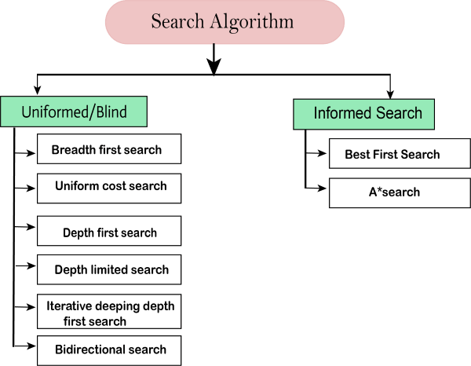
Types of search algorithms

Slide 9
Uni
Un-Informed Search: Blind Search:
Search without any Information
No knowledge
Time Consuming
More Complexity ( Time , Space)
DFS , BFS etc….
Informed Search:
Search with Information
Use knowledge to find the solution
Quick Solution
Less Complexity (Time , Space)
BFS, A* Algorithm, etc….

Slide 10
1. Breadth-first Search:
Breadth-first search is the most common search strategy for traversing a tree or graph. This algorithm searches breadth wise in a tree or graph, so it is called breadth-first search.
BFS algorithm starts searching from the root node of the tree and expands all successor node at the current level before moving to nodes of next level.
The breadth-first search algorithm is an example of a general-graph search algorithm.
Breadth-first search implemented using FIFO queue data structure.
Advantages:
BFS will provide a solution if any solution exists.
If there are more than one solutions for a given problem, then BFS will provide the minimal solution which requires the least number of steps.
Disadvantages:
It requires lots of memory since each level of the tree must be saved into memory to expand the next level.
BFS needs lots of time if the solution is far away from the root node.

Slide 11
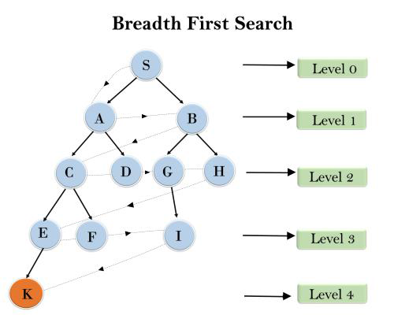
Example
In the below tree structure, we have shown the traversing of the tree using BFS algorithm from the root node S to goal node K. BFS search algorithm traverse in layers, so it will follow the path which is shown by the dotted arrow, and the traversed path will be:
1. S---> A--->B---->C--->D---->G--->H--->E---->F---->I---->K

Slide 12
Time Complexity: Time Complexity of BFS algorithm can be obtained by the number of nodes traversed in BFS until the shallowest Node. Where the d= depth of shallowest solution and b is a node at every state.
T (b) = 1+b2+b3+.......+ bd= O (bd)
Space Complexity: Space complexity of BFS algorithm is given by the Memory size of frontier which is O(bd).
Completeness: BFS is complete, which means if the shallowest goal node is at some finite depth, then BFS will find a solution.
Optimality: BFS is optimal if path cost is a non-decreasing function of the depth of the node.

Slide 13
2. Depth-first Search
Depth-first search is a recursive algorithm for traversing a tree or graph data structure.
It is called the depth-first search because it starts from the root node and follows each path to its greatest depth node before moving to the next path.
DFS uses a stack data structure for its implementation.
The process of the DFS algorithm is similar to the BFS algorithm.
Note: Backtracking is an algorithm technique for finding all possible solutions using recursion.

Slide 14
Advantage: vantage:
o DFS requires very less memory as it only needs to store a stack of the nodes on the path from root node to the current node.
o It takes less time to reach to the goal node than BFS algorithm (if it traverses in the right path).
Disadvantage:
o There is the possibility that many states keep re-occurring, and there is no guarantee of finding the solution.
o DFS algorithm goes for deep down searching and sometime it may go to the infinite loop.

Slide 15
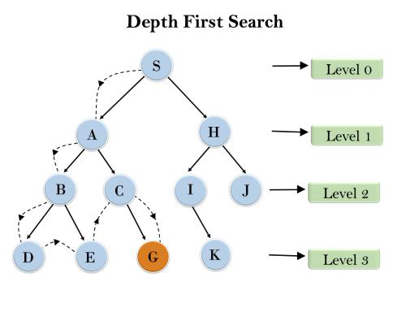
In the below search tree, we have shown the flow of depth-first search, and it will follow the order as:
Root node--->Left node ----> right node.
It will start searching from root node S
S A B D E C G

Slide 16
Completeness:
DFS search algorithm is complete within finite state space as it will expand every node within a limited search tree.
Time Complexity:
Time complexity of DFS will be equivalent to the node traversed by the algorithm. It is given by:
T(b)= 1+ b2+ b3 +.........+ b^d=O(b^d)
Where, d= maximum depth of any node and this can be much larger than d (Shallowest solution depth)
Space Complexity:
DFS algorithm needs to store only single path from the root node, hence space complexity of DFS is equivalent to the size of the fringe set, which is O(bd).
Optimal:
DFS search algorithm is non-optimal, as it may generate a large number of steps or high cost to reach to the goal node.

Slide 17
3. Depth-Limited Search Algorithm:
A depth-limited search algorithm is similar to depth-first search with a predetermined limit. Depth-limited search can solve the drawback of the infinite path in the Depth-first search. In this algorithm, the node at the depth limit will treat as it has no successor nodes further.
Depth-limited search can be terminated with two Conditions of failure:
Standard failure value: It indicates that problem does not have any solution.
Cutoff failure value: It defines no solution for the problem within a given depth limit.
Advantages:
Depth-limited search is Memory efficient.
Disadvantages:
o Depth-limited search also has a disadvantage of incompleteness.
o It may not be optimal if the problem has more than one solution.

Slide 18
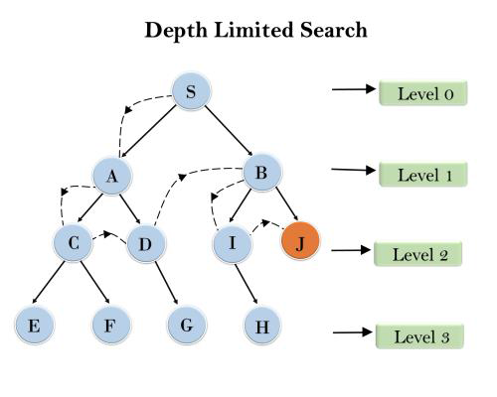
Example:
Completeness: DLS search algorithm is complete if the solution is above the depth-limit.
Time Complexity: Time complexity of DLS algorithm is O(b^d).
Space Complexity: Space complexity of DLS algorithm is O(b×d).
Optimal: Depth-limited search can be viewed as a special case of DFS, and it is also not optimal even if ℓ>d.

Slide 19
4. Uniform-cost Search Algorithm:
Uniform-cost search is a searching algorithm used for traversing a weighted tree or graph. This algorithm comes into play when a different cost is available for each edge. The primary goal of the uniform-cost search is to find a path to the goal node which has the lowest cumulative cost. Uniform-cost search expands nodes according to their path costs form the root node. It can be used to solve any graph/tree where the optimal cost is in demand. A uniform-cost search algorithm is implemented by the priority queue. It gives maximum priority to the lowest cumulative cost. Uniform cost search is equivalent to BFS algorithm if the path cost of all edges is the same.
Advantages:
o Uniform cost search is optimal because at every state the path with the least cost is chosen.
Disadvantages:
o It does not care about the number of steps involve in searching and only concerned about path cost. Due to which this algorithm may be stuck in an infinite loop.

Slide 20
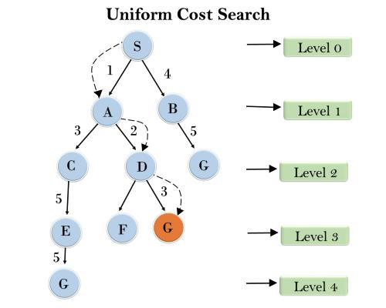
Example:
Completeness:
Uniform-cost search is complete, such as if there is a solution, UCS will find it.

Slide 21
5. Iterative deepening depth-first Search:
The iterative deepening algorithm is a combination of DFS and BFS algorithms. This search algorithm finds out the best depth limit and does it by gradually increasing the limit until a goal is found.
This algorithm performs depth-first search up to a certain "depth limit", and it keeps increasing the depth limit after each iteration until the goal node is found.
This Search algorithm combines the benefits of Breadth-first search's fast search and depth-first search's memory efficiency.
The iterative search algorithm is useful uninformed search when search space is large, and depth of goal node is unknown.
Advantages:
It combines the benefits of BFS and DFS search algorithm in terms of fast search and memory efficiency.
Disadvantages:
The main drawback of IDDFS is that it repeats all the work of the previous phase.

Slide 22
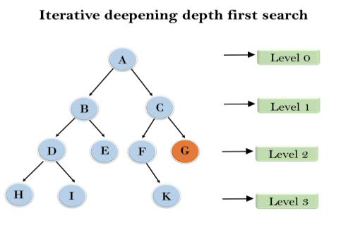
Example:
Following tree structure is showing the iterative deepening depth-first search. IDDFS algorithm performs various iterations until it does not find the goal node. The iteration performed by the algorithm is given as:
1'st Iteration-----> A
2'nd Iteration----> A, B, C
3'rd Iteration------>A, B, D, E, C, F, G
4'th Iteration------>A, B, D, H, I, E, C, F, K, G In the fourth iteration, the algorithm will find the goal node.

Slide 23
Completeness:
This algorithm is complete if the branching factor is finite.
Time Complexity:
Let's suppose b is the branching factor and depth is d then the worst-case time complexity is O(b^d).
Space Complexity:
The space complexity of IDDFS will be O(b*d).
Optimal:
IDDFS algorithm is optimal if path cost is a non- decreasing function of the depth of the node.

Slide 24
6. Bidirectional Search Algorithm:
Bidirectional search algorithm runs two simultaneous searches, one form initial state called as forward-search and other from goal node called as backward-search, to find the goal node.
Bidirectional search replaces one single search graph with two small subgraphs in which one starts the search from an initial vertex and other starts from goal vertex. The search stops when these two graphs intersect each other.
Bidirectional search can use search techniques such as BFS, DFS, DLS, etc.
Advantages:
Bidirectional search is fast.
Bidirectional search requires less memory
Disadvantages:
Implementation of the bidirectional search tree is difficult.
In bidirectional search, one should know the goal state in advance.

Slide 25
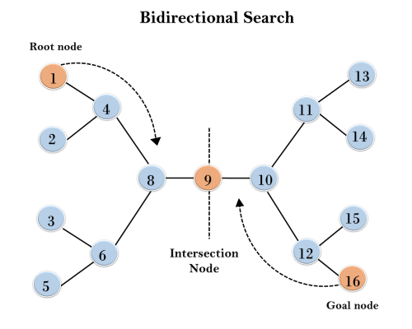
Example
In the below search tree, bidirectional search algorithm is applied. This algorithm divides one graph/tree into two sub-graphs. It starts traversing from node 1 in the forward direction and starts from goal node 16 in the backward direction.
The algorithm terminates at node 9 where two searches meet.
Completeness: Bidirectional Search is complete if we use BFS in both searches.
Time Complexity: Time complexity of bidirectional search using BFS is O(b^{d}).
Space Complexity: Space complexity of bidirectional search is O(b^{d}).
Optimal: Bidirectional search is Optimal.

Slide 26
Informed Search Algorithms
So far we have talked about the uninformed search algorithms which looked through search space for all possible solutions of the problem without having any additional knowledge about search space.
But informed search algorithm contains an array of knowledge such as how far we are from the goal, path cost, how to reach to goal node, etc.
This knowledge help agents to explore less to the search space and find more efficiently the goal node.
The informed search algorithm is more useful for large search space.
Informed search algorithm uses the idea of heuristic, so it is also called Heuristic search.

Slide 27
Heuristics function:
Heuristic is a function which is used in Informed Search, and it finds the most promising path.
It takes the current state of the agent as its input and produces the estimation of how close agent is from the goal. The heuristic method, however, might not always give the best solution, but it guaranteed to find a good solution in reasonable time.
Heuristic function estimates how close a state is to the goal. It is represented by h(n), and it calculates the cost of an optimal path between the pair of states.
The value of the heuristic function is always positive.
Admissibility of the heuristic function is given as:
1. h(n) <= h*(n)
Here h(n) is heuristic cost, and h*(n) is the estimated cost. Hence heuristic cost should be less than or equal to the estimated cost.

Slide 28
1.) Best-first Search Algorithm (Greedy Search):
Best-first search algorithm always selects the path which appears best at that moment.
It is the combination of depth-first search and breadth-first search algorithms.
In the best first search algorithm, we expand the node which is closest to the goal node and the closest cost is estimated by heuristic function, i.e.
f(n)= h(n)
Where, g(n) = Cost from start node to current node n
h(n)= estimated cost from node n to the goal node
The Best first Search algorithm is implemented by the priority queue.
Example:
Consider the below search problem, and we will traverse it using greedy best-first search. At each iteration, each node is expanded using evaluation function f(n)=h(n) , which is given in the below table.

Slide 29
Best first search algorithm:
Step 1: Place the starting node into the OPEN list.
Step 2: If the OPEN list is empty, Stop and return failure.
Step 3: Remove the node n, from the OPEN list which has the lowest value of f(n), and places it in the CLOSED list.
Step 4: Expand the node n, and generate the successors of node n.
Step 5: Check each successor of node n, and find whether any node is a goal node or not. If any successor node is goal node, then return success and terminate the search, else proceed to Step 6.
Step 6: For each successor node, algorithm checks for evaluation function f(n), and then check if the node has been in either OPEN or CLOSED list. If the node has not been in both list, then add it to the OPEN list.
Step 7: Return to Step 2.

Slide 30
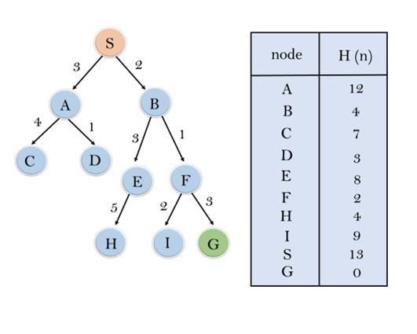
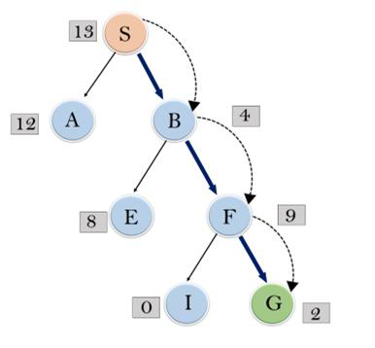
Expand the nodes of S and put in the CLOSED list
Initialization: Open [A, B], Closed [S]
Iteration 1: Open [A], Closed [S, B]
Iteration 2: Open [E, F, A], Closed [S, B] : Open [E, A], Closed [S, B, F]
Iteration 3: Open [I, G, E, A], Closed [S, B, F] : Open [I, E, A], Closed [S, B, F, G]
Hence the final solution path will be: S----> B----->F----> G
.

Slide 31
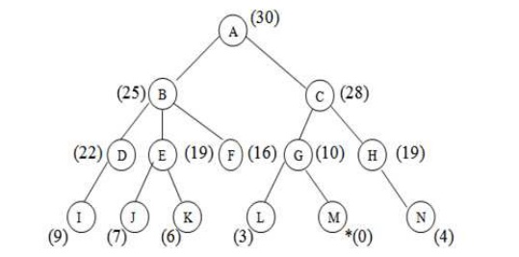
Example BFS: Find the path from A to reach goal node G

Slide 32
Advantages:
Best first search can switch between BFS and DFS by gaining the advantages of both the algorithms.
This algorithm is more efficient than BFS and DFS algorithms.
Disadvantages:
It can behave as an unguided depth-first search in the worst case scenario.
It can get stuck in a loop as DFS.
This algorithm is not optimal.

Slide 33
Time Complexity: The worst case time complexity of Greedy best first search is O(b^d).
Space Complexity: The worst case space complexity of Greedy best first search is O(bd). Where, d is the maximum depth of the search space.
Complete: Greedy best-first search is also incomplete, even if the given state space is finite.
Optimal: Greedy best first search algorithm is not optimal.

Slide 34
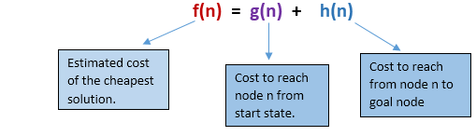
2.) A* Search Algorithm:
A* search is the most commonly known form of best-first search. It uses heuristic function h(n), and cost to reach the node n from the start state g(n).
It has combined features of UCS and greedy best-first search, by which it solve the problem efficiently.
This search algorithm expands less search tree and provides optimal result faster.
A* algorithm uses g(n)+h(n) instead of g(n).
In A* search algorithm, we use search heuristic as well as the cost to reach the node. Hence we can combine both costs as following, and this sum is called as a fitness number.

Slide 35
At each point in the search space, only those node is expanded which have the lowest value of f(n), and the algorithm terminates when the goal node is found.
Algorithm of A* search:
Step1: Place the starting node in the OPEN list.
Step 2: Check if the OPEN list is empty or not, if the list is empty then return failure and stops.
Step 3: Select the node from the OPEN list which has the smallest value of evaluation function (g+h), if node n is goal node then return success and stop, otherwise
Step 4: Expand node n and generate all of its successors, and put n into the closed list. For each successor n', check whether n' is already in the OPEN or CLOSED list, if not then compute evaluation function for n' and place into Open list.
Step 5: Else if node n' is already in OPEN and CLOSED, then it should be attached to the back pointer which reflects the lowest g(n') value.
Step 6: Return to Step 2.

Slide 36
Advantages:
o A* search algorithm is the best algorithm than other search algorithms.
o A* search algorithm is optimal and complete.
o This algorithm can solve very complex problems.
Disadvantages:
o It does not always produce the shortest path as it mostly based on heuristics and approximation.
o A* search algorithm has some complexity issues.
o The main drawback of A* is memory requirement as it keeps all generated nodes in the memory, so it is not practical for various large-scale problems.

Slide 37
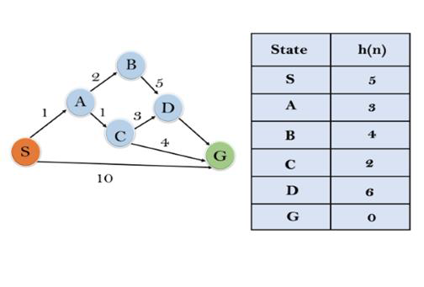
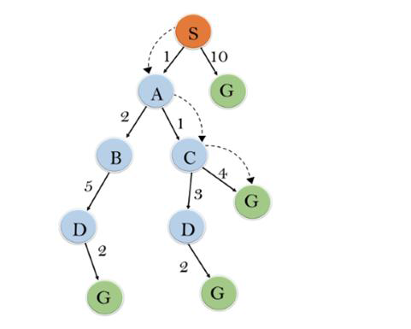
Example:
In this example, we will traverse the given graph using the A* algorithm. The heuristic value of all states is given in the below table so we will calculate the f(n) of each state using the formula f(n)= g(n) + h(n), where g(n) is the cost to reach any node from start state.
Here we will use OPEN and CLOSED list.
Solution:

Slide 38
Initialization: {(S, 5)}
Iteration1: {(S--> A, 4), (S-->G, 10)}
Iteration2: {(S--> A-->C, 4), (S--> A-->B, 7), (S-->G, 10)}
Iteration3: {(S--> A-->C--->G, 6), (S--> A-->C--->D, 11), (S--> A-->B, 7), (S-->G, 10)}
Iteration 4 : It will give the final result, as S--->A--->C--->G it provides the optimal path with cost 6.
Points to remember:
o A* algorithm returns the path which occurred first, and it does not search for all remaining paths.
o The efficiency of A* algorithm depends on the quality of heuristic.
o A* algorithm expands all nodes which satisfy the condition f(n)<="" li="">
Complete: A* algorithm is complete as long as:
o Branching factor is finite.
o Cost at every action is fixed.

Slide 39
Optimal: A* search algorithm is optimal if it follows below two conditions:
o Admissible: The first condition requires for optimality is that h(n) should be an admissible heuristic for A* tree search. An admissible heuristic is optimistic in nature.
o Consistency: Second required condition is consistency for only A* graph-search.
If the heuristic function is admissible, then A* tree search will always find the least cost path.
Time Complexity: The time complexity of A* search algorithm depends on heuristic function, and the number of nodes expanded is exponential to the depth of solution d. So the time complexity is O(b^d), where b is the branching factor.
Space Complexity: The space complexity of A* search algorithm is O(b^d)

Slide 40
3. AO* Algorithm / AND OR GRAPH
AND OR graph Useful for certain problems where
The solution involves decomposing the problem into smaller problems.
We then solve these smaller problems.
Like A* algorithm here we will use two arrays and one heuristic function.
OPEN:
It contains the nodes that has been traversed but yet not been marked solvable or unsolvable.
CLOSE:
It contains the nodes that have already been processed.

Slide 41
Algorithm:
Step 1: Place the starting node into OPEN.
Step 2: Compute the most promising solution tree say T0.
Step 3: Select a node n that is both on OPEN and a member of T0. Remove it from OPEN and place it in CLOSE
Step 4: If n is the terminal goal node then leveled n as solved and leveled all the ancestors of n as solved. If the starting node is marked as solved then success and exit.
Step 5: If n is not a solvable node, then mark n as unsolvable. If starting node is marked as unsolvable, then return failure and exit.
Step 6: Expand n. Find all its successors and find their h (n) value, push them into OPEN.
Step 7: Return to Step 2.
Step 8: Exit.

Slide 42
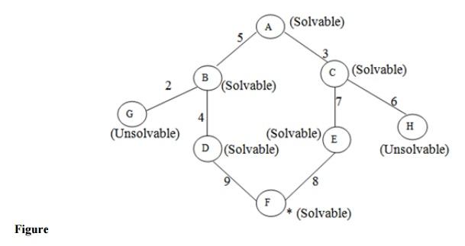
In the above graph, the solvable nodes are A, B, C, D, E, F and the unsolvable nodes are G, H. Take A as the starting node. So place A into OPEN.

Slide 43
Advantages:
It is an optimal algorithm.
If traverse according to the ordering of nodes.
It can be used for both OR and AND graph.
Disadvantages:
Sometimes for unsolvable nodes, it can’t find the optimal path.
Its complexity is than other algorithms.

Slide 44
Hill Climbing Algorithm in Artificial Intelligence
Hill climbing algorithm is a local search algorithm which continuously moves in the direction of increasing elevation/value to find the peak of the mountain or best solution to the problem. It terminates when it reaches a peak value where no neighbor has a higher value.
Hill climbing algorithm is a technique which is used for optimizing the mathematical problems. One of the widely discussed examples of Hill climbing algorithm is Traveling-salesman Problem in which we need to minimize the distance traveled by the salesman.

Slide 45
It is also called greedy local search as it only looks to its good immediate neighbor state and not beyond that.
A node of hill climbing algorithm has two components which are state and value.
Hill Climbing is mostly used when a good heuristic is available.
In this algorithm, we don't need to maintain and handle the search tree or graph as it only keeps a single current state.

Slide 46
Features of Hill Climbing:
Following are some main features of Hill Climbing Algorithm:
Generate and Test variant: Hill Climbing is the variant of Generate and Test method. The Generate and Test method produce feedback which helps to decide which direction to move in the search space.
Greedy approach: Hill-climbing algorithm search moves in the direction which optimizes the cost.
No backtracking: It does not backtrack the search space, as it does not remember the previous states.

Slide 47
State-space Diagram for Hill Climbing:
The state-space landscape is a graphical representation of the hill-climbing algorithm which is showing a graph between various states of algorithm and Objective function/Cost.
On Y-axis we have taken the function which can be an objective function or cost function, and state-space on the x-axis. If the function on Y-axis is cost then, the goal of search is to find the global minimum and local minimum. If the function of Y-axis is Objective function, then the goal of the search is to find the global maximum and local maximum.

Slide 48
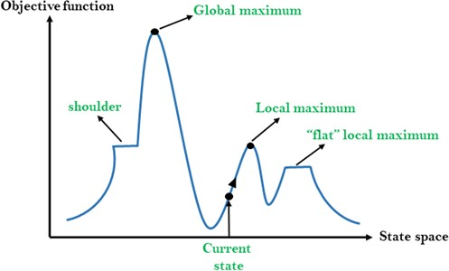

Slide 49
Problems in Hill Climbing Algorithm:
1. Local Maximum: A local maximum is a peak state in the landscape which is better than each of its neighboring states, but there is another state also present which is higher than the local maximum.
Solution: Backtracking technique can be a solution of the local maximum in state space landscape. Create a list of the promising path so that the algorithm can backtrack the search space and explore other paths as well.
2. Plateau: A plateau is the flat area of the search space in which all the neighbor states of the current state contains the same value, because of this algorithm does not find any best direction to move. A hill-climbing search might be lost in the plateau area.
Solution: The solution for the plateau is to take big steps or very little steps while searching, to solve the problem. Randomly select a state which is far away from the current state so it is possible at the algorithm could find non-plateau region.

Slide 50
3. Ridges: A ridge is a special form of the local maximum. It has an area which is higher than its surrounding areas, but itself has a slope, and cannot be reached in a single move.
Solution: With the use of bidirectional search, or by moving in different directions, we can improve this problem.
Types of Hill Climbing Algorithm:
Simple hill Climbing
Steepest-Ascent hill-climbing
Stochastic hill-climbing
Simple Hill Climbing:
Simple hill climbing is the simplest way to implement a hill climbing algorithm. It only evaluates the neighbor node state at a time and selects the first one which optimizes current cost and set it as a current state. It only checks it's one successor state, and if it finds better than the current state, then move else be in the same state. This algorithm has the following features:
Less time consuming
Less optimal solution and the solution is not guaranteed

Slide 51
Algorithm for Simple Hill Climbing:
Step 1: Evaluate the initial state, if it is goal state then return success and Stop.
Step 2: Loop Until a solution is found or there is no new operator left to apply.
Step 3: Select and apply an operator to the current state.
Step 4: Check new state:
If it is goal state, then return success and quit.
Else if it is better than the current state then assign new state as a current state.
Else if not better than the current state, then return to step2.
Step 5: Exit.
Steepest-Ascent hill climbing:
The steepest-Ascent algorithm is a variation of simple hill climbing algorithm. This algorithm examines all the neighboring nodes of the current state and selects one neighbor node which is closest to the goal state. This algorithm consumes more time as it searches for multiple neighbors

Slide 52
Algorithm for Steepest-Ascent hill climbing:
Step 1: Evaluate the initial state, if it is goal state then return success and stop, else make current state as initial state.
Step 2: Loop until a solution is found or the current state does not change.
Let SUCC be a state such that any successor of the current state will be better than it.
For each operator that applies to the current state:
Apply the new operator and generate a new state.
Evaluate the new state.
If it is goal state, then return it and quit, else compare it to the SUCC.
If it is better than SUCC, then set new state as SUCC.
If the SUCC is better than the current state, then set current state to SUCC.
Step 3: Exit.

Slide 53
3. Stochastic hill climbing: It does not examine all the neighboring nodes before deciding which node to select. It just selects a neighboring node at random and decides (based on the amount of improvement in that neighbor) whether to move to that neighbor or to examine another.
Step 1: Evaluate the initial state. If it is a goal state then stop and return success. Otherwise, make the initial state the current state.
Step 2: Repeat these steps until a solution is found or the current state does not change.
a) Select a state that has not been yet applied to the current state.
b) Apply successor function to the current state and generate all the neighbor states.
c) Among the generated neighbor states which are better than the current state choose a state randomly (or based on some probability function).
d) If the chosen state is the goal state, then return success, else make it the current state and repeat step 2: b) part.
Step 3: Exit.

Slide 54
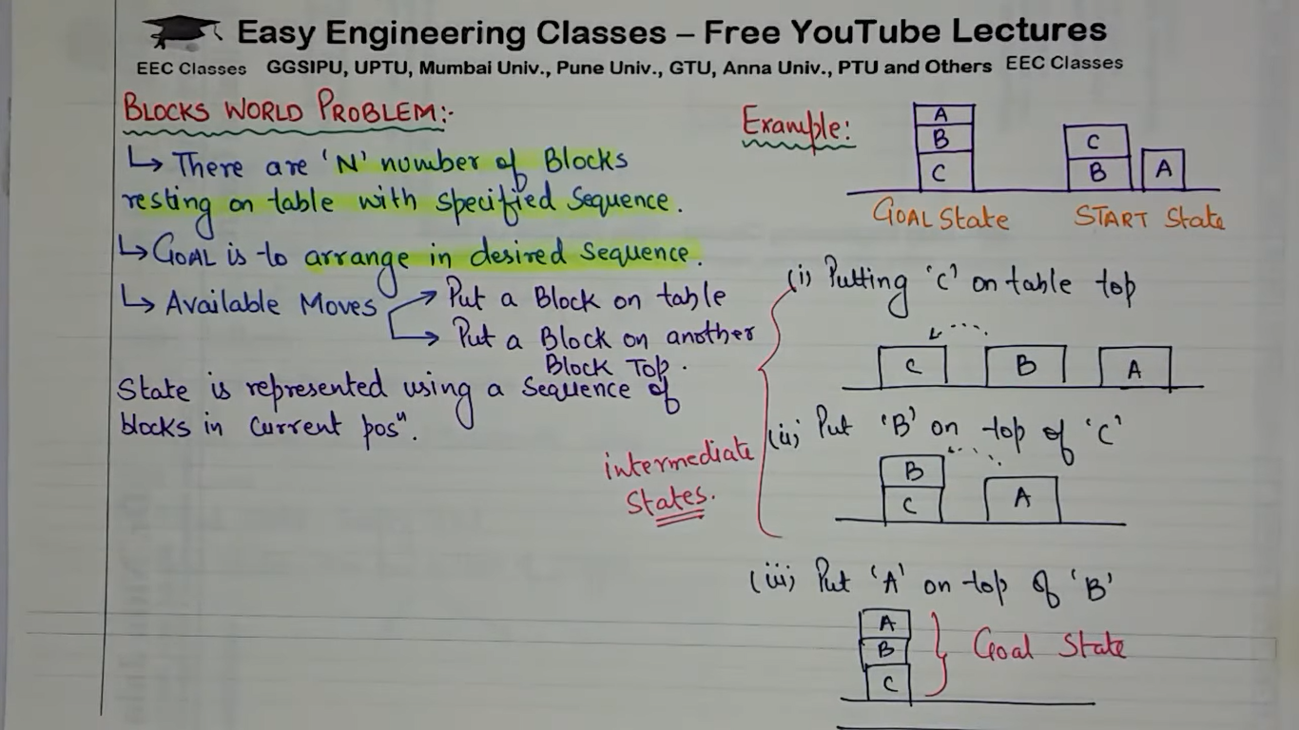

Slide 55
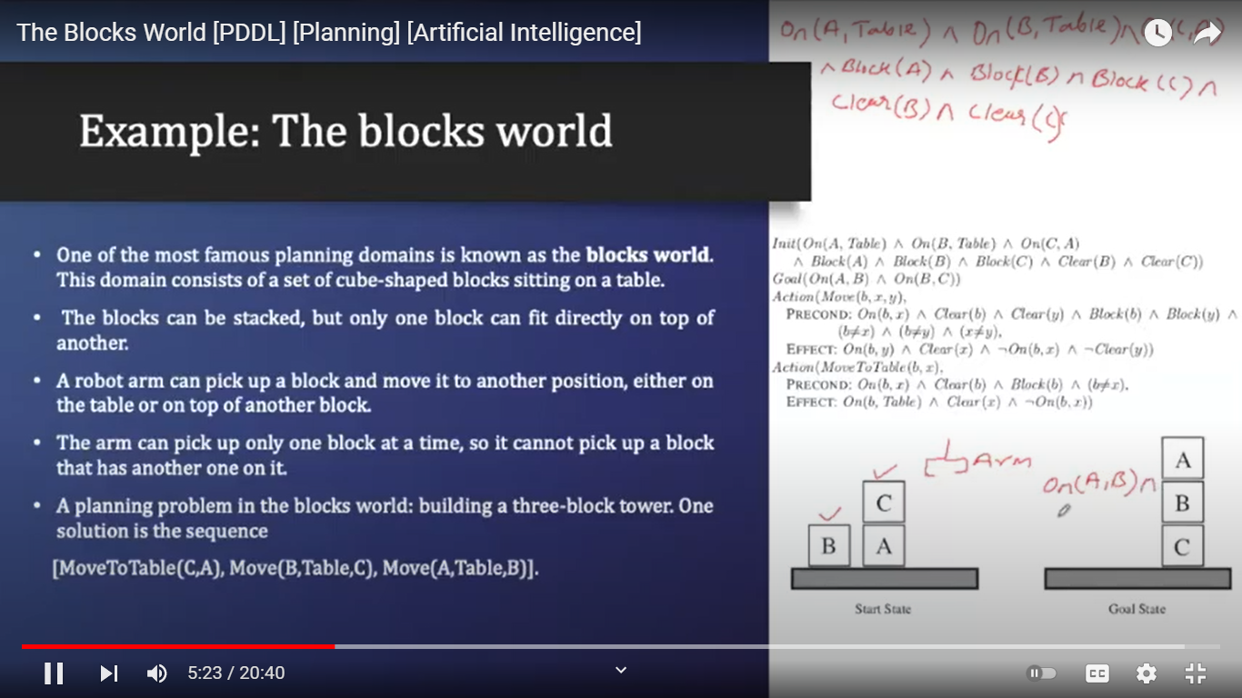

Slide 56
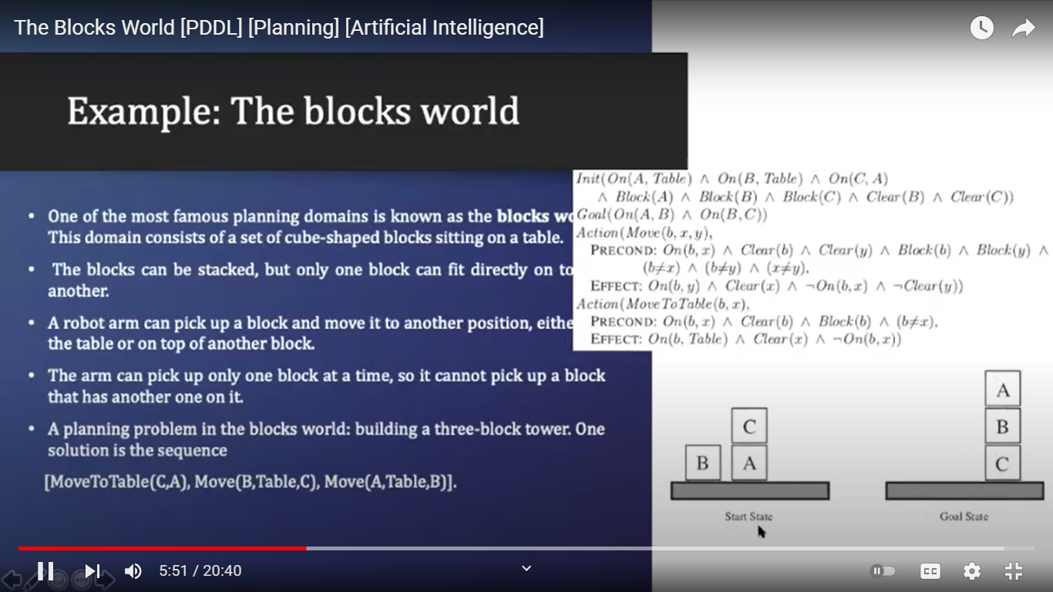

Slide 57
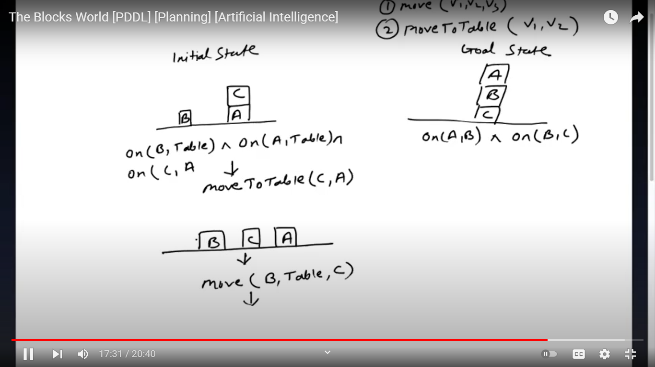

Slide 58
THANK YOU

